Slide 1
Literature search Binaural beat
20.10.12

Slide 2
Neural Background
Working memory tasks involving visuospatial information
Prefrontal cortex (PFC), often right lateralized
Working memory maintenance
Prefrontal and parietal neuronal mechanism
Working memory task difficulty ↑
Connectivity between prefrontal and parietal areas ↑

Slide 3
Neural Background
Electrocortical phase synchronization ↑
Neural communication, neural plasticity, working memory ↑
Highest amount of synchronization in the auditory cortex
Beta band at 16 Hz BB (Fitzpatrick DC, et al., 2009)
Largest EEG steady state response within the gamma band
40Hz BB
Frontal and parietal lobes
BB stimulation in the alpha band created the highest steady state response (Ioannou et al., 2015)
Both musicians and non-musicians

Slide 4
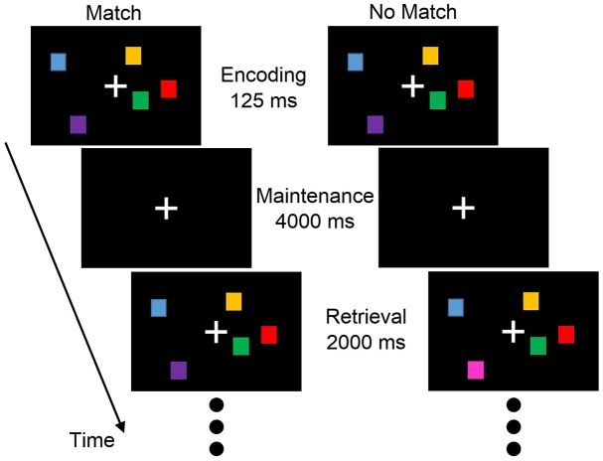
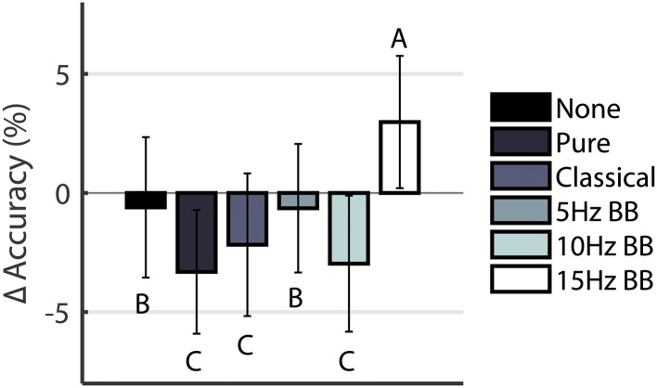

BB & Working Memory
[The Effect of Binaural Beats on Visuospatial Working Memory and Cortical Connectivity]
Beauchene et al., 2016
Visuospatial Working Memory
None, Pure Tone, Classical Music, 5Hz BB (theta), 10Hz BB (alpha), 15Hz BB (beta) (240Hz 245Hz; 250Hz; 255Hz)
15Hz BB – Response accuracy ↑, Cortical networks ↑
Others – Accuracy ↓
Visuospatial Task
Delayed match-to-sample visuospatial working memory task
30 min (5 min * 6 acoustic stimulation condition)
Notes:
The Effect of Binaural Beats on Visuospatial Working Memory and Cortical Connectivity
Capacity: C is the load, H is the hit rate, and F is the false alarm rate.
28 people.
5분 동안 계속. Encoding, Maintenance, Retrieval.

Slide 5
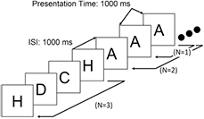
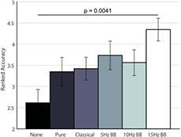
BB & Working Memory
[The effect of binaural beats on verbal working memory and cortical connectivity]
Beauchene et al., 2017
Verbal Working Memory
Same acoustic stimulation
N-Back Task
Only 15 Hz BB produced significant change
Notes:
5분 동안 계속, 2분 쉬고.
Encoding, Maintenance, Retrieval.

Slide 6
BB vs MB
[The Effects of Binaural and Monoaural Beat Stimulation on Cognitive Functioning in Subjects with Different Levels of Emotionality]
Hessel Engelbregt, et al. 2019
Low emotionality vs High Emotionality
WN, BB, MB (40Hz low gamma; 440Hz 480Hz)
The BB and MB were masked with white noise
Testing took 1 hour
Notes:
Masking 통해 white noise로 인해 발생할 수 있는 불쾌감으로 인한 효과 감소.

Slide 7
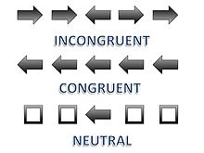

BB vs MB
Flanker Task
Modified Corsi block-tapping test
Klingberg Task
 | O
 |  | O
Reaction times (RTs)
Number of errors
Maximum reached stage

Slide 8
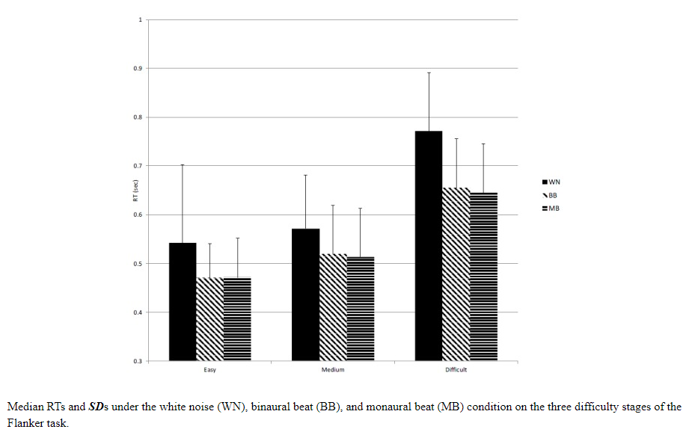
BB vs MB
1. Flanker task – Attention and inhibition
Slower RT under the WN condition as compared to the MB and BB conditions
No significant differences between the MB and the BB
Low and high emotional participants resulted in similar effects of MB and BB on the RTs (in the Flanker task)
Quality of performance - No significant differences
2. Klingberg working memory task – Visuospatial working memory
No significant differences
Absence of effects of MB and BB on the quality of attention (Crespo et al., 2013; Kennel, Taylor, Lyon, & Bourguignon, 2010)
Notes:
Improvement in working memory capacity↔ (Beauchene at al., 2016; Kraus & Porubanová, 2015).
Ceiling effect

Slide 9
Does duration of ABS matters?
Effect of Binaural Stimulation on Attention and EEG]
Crespo et al., 2013 X
2 binaural beats on theta (4Hz) and beta (16Hz)
20-min stimulation
Cognitive Test – No siginicant difference
Perception of differences – assess the speed and hits in partially ordered stimulation pattern similarities and differences (positive correlation with general intelligence)
EMAV test – assess the attion capacity and effectiveness in children and adults.
Five Digit Test – evaluate cognitive processing speed
EEG recording brain activity – No siginicant difference
Notes:
Visual-spatial memory와는 직접적 관련 X
Crespo et al. Effect of Binaural Stimulation on Attention and EEG
Perception of difference – determine which of the three faces is different from other two
faster reaction times in participants who had listened to BBs of 40 Hz (Colzato et al., 2017).

Slide 10
Does duration of ABS matters?
[Pilot Feasibility Study of Binaural Auditory Beats for Reducing Symptoms of Inattention in Children and Adolescents with Attention-Deficit/Hyperactivity Disorder]
Kennel et al., 2010 X
20 min, three times a week for three weeks
ADHD children and adolescents
No accurate information about Hz
Notes:
Pilot Feasibility Study of Binaural Auditory Beats for Reducing Symptoms of Inattention in Children and Adolescents with Attention-Deficit/Hyperactivity Disorder

Slide 11
Does duration of ABS matters?
[Binaural Auditory Beats Affect Vigilance Performance and Mood]
Lane et al., 1998 O
Pink noise containing simple tones or binaural beats (16, 24 Hz beta) (1.5, 4 Hz theta/delta range)
30 min on three different days
Beta-frequency BB – more correct target detections and fewer false alarms than presentation of theta/delta frequency BB
Beta-frequency BB – less negative mood
Notes:
Binaural Auditory Beats Affect Vigilance Performance and Mood

Slide 12
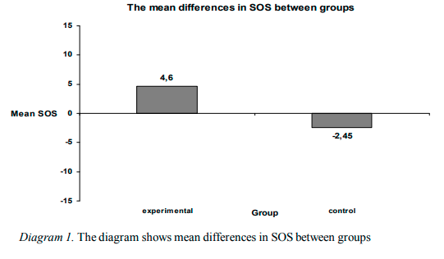
Does duration of ABS matters?
[The Effects of Binaural Beats on Working Memory Capacity]
Kraus & Porubanova, 2015 O
Working memory capacity
Only 12 min
9.55 Hz (220.45 Hz 230 Hz; alpha)
Masked with the sound of sea
Automated Operation Span Task
Retain randomly presented series of 3 to 7 defined letters (800ms per letter)
Simple mathematical equation (2*3)+7=? (True/False)
Mathematical equation + Retain letters
P=0.017
Notes:
후보군에는 11개의 letter. 75 letters and 75 mathematical equation.
50 students
THE EFFECT OF BINAURAL BEATS ON WORKING MEMORY CAPACITY
AOSPAN, 12 분 소리 듣고, AOSPAN
https://www.youtube.com/watch?v=wp4z41Jax6g&ab_channel=zupef

Slide 13
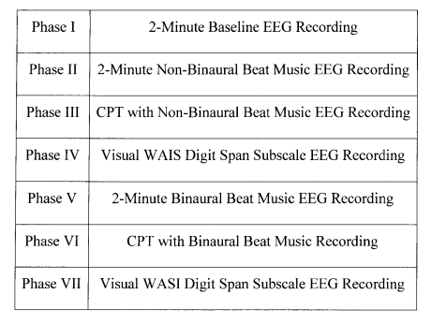
Does duration of ABS matters?
McMurray (2006) O
Assessed the effect of 7 and 11 Hz BB on the alpha brainwave activity, working memory, and attention
Healthy elderly, who are known for their gradual decrease in physiological alpha activity
2 minutes exposure to BB → Alpha brain wave changed
While CPT, before Digit Span
Improvements in Forward and Backward Digit Span Memory tasks, and in a version of Continuous Performance Task
Limitation
Older people have different quality of brainwave activity
Different WMC tests
Notes:
Binaural beats enhance alpha wave activity, memory and attention in healthy aging seniors
Forward and Backward Digit Span Memory tasks – 숫자 순서대로 기억 Ex) 5,7,2
Continuous Performance Task – 화면에 글씨들이 나타났다 사라지는데 특정 문자가 나타났을 때 버튼 눌러야 함

Slide 14
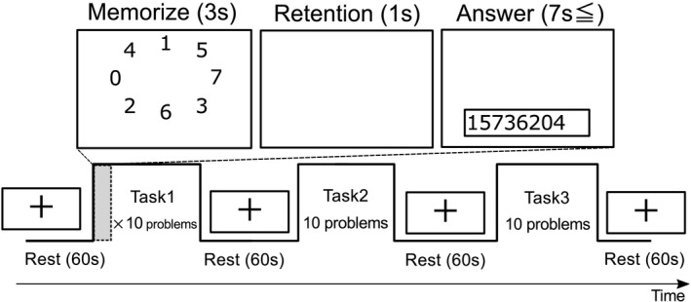
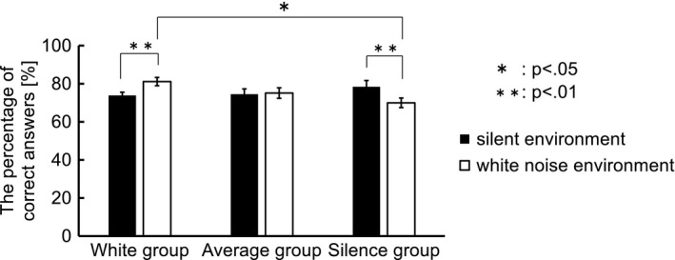
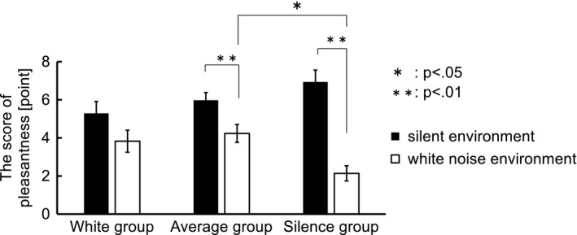
Individual difference?
Why duration of ABS doesn’t matter?
Pleasantness
Hiwa, Katayama, & Hiroyasu, 2018
Short-term memory task performance ∝ WN Pleasantness
Three groups (Pleasantness of the auditory environment, VAS)
White group/Average group/Silence group
Number memory task
Unpleasant (0)
Pleasant (10)
Notes:
Functional near‐infrared spectroscopy study of the neural correlates between auditory environments and intellectual work performance
fNIRS 29 subjects. 8, 13, 8 people. 10 problems.
Number memory task 시계 방향으로 숫자를 기억한 후 입력

Slide 15
가설: Duration of ABS가 큰 상관이 없는 이유 – 어쩌면 white noise 때처럼 pleasantness에 따라 달라지는 것일 수도 있음
한 번 평가해보는 것도?
만약 white noise를 비교군으로 사용할 것이라면 masking 필요
추가로 할 만한 Hz 5(theta), 25(beta), 40(low gamma)
9.55Hz alpha
Beta 16Hz 15Hz

Slide 16
White noise에 대한 pleasantness 논문
Working memory capacity에 대한 논문
Visual-spatial memory에 대한 논문
BB vs MB
어떤 주파수를 쓸 것인가?
얼마나 오래 ABS를 들려줄 것인가?
MB와 BB의 차이는 있는가?
Working memory (특히, visual-spatial memory)에 관한 선행연구가 있는가?
(neural mechanism?)
Encoding, Maintenance, Retrieval 모두 소리? 5s/5s
Task에서 정답을 누르면 바로 넘어가게 하는게 맞는가?
Practice 넣기. 순서의 영향 최소화.
약 30명 대상.
Notes:
Pleasantness (Hiwa, Katayama, & Hiroyasu, 2018).
Functional near‐infrared spectroscopy study of the neural correlates between auditory environments and intellectual work performance

Slide 17
Experimental Design
5 min per sound condition
Encoding + Maintenance + Retrieval (All sound)
5 min/(10 Image*3 Spatiotemporal condition)=10 s
Encoding phase
Image 1
Image 2
Image 3
Image 10
5s
5s
5s
5s
Image 1
Retrieval phase
5s

Slide 18
Experimental Design
About 30 subjects
4 Runs
Only binaural set
1 No sound
3 10Hz, 15Hz, 40Hz
Monaural & Binaural set
2 No sound
1 Monaural & 1 Binaural 15Hz

Slide 19
Analysis
Correct rate of each condition
Reaction time of each condition
When condition
Sequence interval between images in retrieval
Optional
Pleasantness – Individual difference?

Slide 20
Problems
Difficulty levels vary by image
First-time run might be difficult
Need a training run
The time the subjects are exposed to sound conditions should be similar (~5 min)
Fixed Retrieval's Time

